Slide 1

HOTEL RESERVATION ANALYSIS

Slide 2
C
O
N
T
E
N
T
S
INTRODUCTION
DATASET DESCRIPTION
DATA EXPLORATION & ANALYSIS
INSIGHTS
CONCLUSION

Slide 3

INTRODUCTION
The hotel industry depends on data to make informed decisions and enhance the guest experience. In this project, I analyzed a comprehensive hotel reservation dataset to uncover insights into guest preferences, booking trends, and other key factors influencing hotel operations.

Slide 4
DATASET DESCRIPTION
Booking_ID: A unique identifier for each hotel reservation.
no_of_adults: The number of adults in the reservation.
no_of_children: The number of children in the reservation.
no_of_weekend_nights: The number of nights in the reservation that fall on weekends.
no_of_week_nights: The number of nights in the reservation that fall on weekdays.
type_of_meal_plan: The meal plan chosen by the guests.
room_type_reserved: The type of room reserved by the guests.
lead_time: The number of days between booking and arrival.
arrival_date: The date of arrival.
market_segment_type: The market segment to which the reservation belongs.
avg_price_per_room: The average price per room in the reservation.
booking_status: The status of the booking.

Slide 5



What is the total number of reservations in the dataset?
.
.
s.

Slide 6


Which meal plan is the most popular among guests?
.
.
s.

Slide 7


What is the average price per room for reservations involving children?
.
.
s.

Slide 8


How many reservations were made for the year 2018
.
.
s.

Slide 9


What is the most commonly booked room type?
.
.
s.

Slide 10


How many reservations fall on a weekend (no_of_weekend_nights > 0)?
.
.
s.

Slide 11

What is the highest and lowest lead time for reservations?
.
.
s.

Slide 12


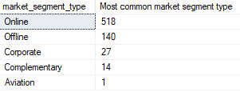
What is the most common market segment type for reservations?
.
.
s.

Slide 13


How many reservations have a booking status of "Confirmed"?
.
.
s.

Slide 14


What is the total number of adults and children across all reservations?
.
.
s.

Slide 15


What is the average number of weekend nights for reservations involving children?
.
.
s.

Slide 16
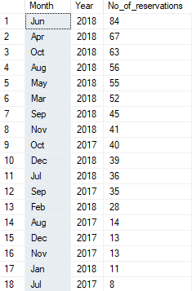

How many reservations were made in each month of the year?
.
.
s.

Slide 17
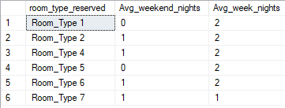
What is the average number of nights (both weekend and weekday) spent by guests for each room type?
.
.
s.

Slide 18
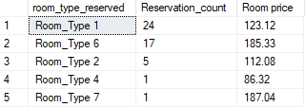
For reservations involving children, what is the most common room type, and what is the average price for that room type?
.
.
s.

Slide 19

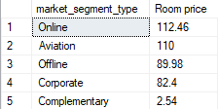
Find the market segment type that generates the highest average price per room
.
.
s.

Slide 20
INSIGHTS
534 guests have chosen Room Type 1, indicating its popularity among our guests.
Meal Plan 1 has been chosen by a total of 527 guests, showcasing its widespread popularity among our guests.
RESERVATIONS
700
Online reservations have been favored by 518 guests, highlighting the convenience and preference for digital booking methods.
Out of all reservations, 493 bookings have been confirmed by our guests, highlighting strong commitment to their stays.

Slide 21
CONCLUSION
Analyzing the hotel reservation dataset yields crucial insights for informed decision-making within the hospitality industry. These insights encompass a deep understanding of guest preferences, popular meal plans, room types, booking trends, and market strategies. Leveraging these data-driven insights not only enhances the guest experience but also empowers hotels to remain competitive, attract the right audience, and drive business success.

Slide 22
THANK YOU
For any inquiries, please feel free to contact :
 nidhigusain914@gmail.com
Nidhi Gusain
Batch : MIP-DA-10

